Slide 1


Project name: Range Buddy Team members: Zachary, Zahra

Slide 2
Executive Summary
Problem: Targets at shooting ranges give very limited information. It's hard to understand what might be the problem in the users aim.
Solution: This project allows users to have instant and precise calculations to help improve their performance. We offer an easy and accessible way for shooters at gun range to have an accurate performance analysis.
Notes:
This creates an organized approach to storing figures on one's accuracy over time.

Slide 3
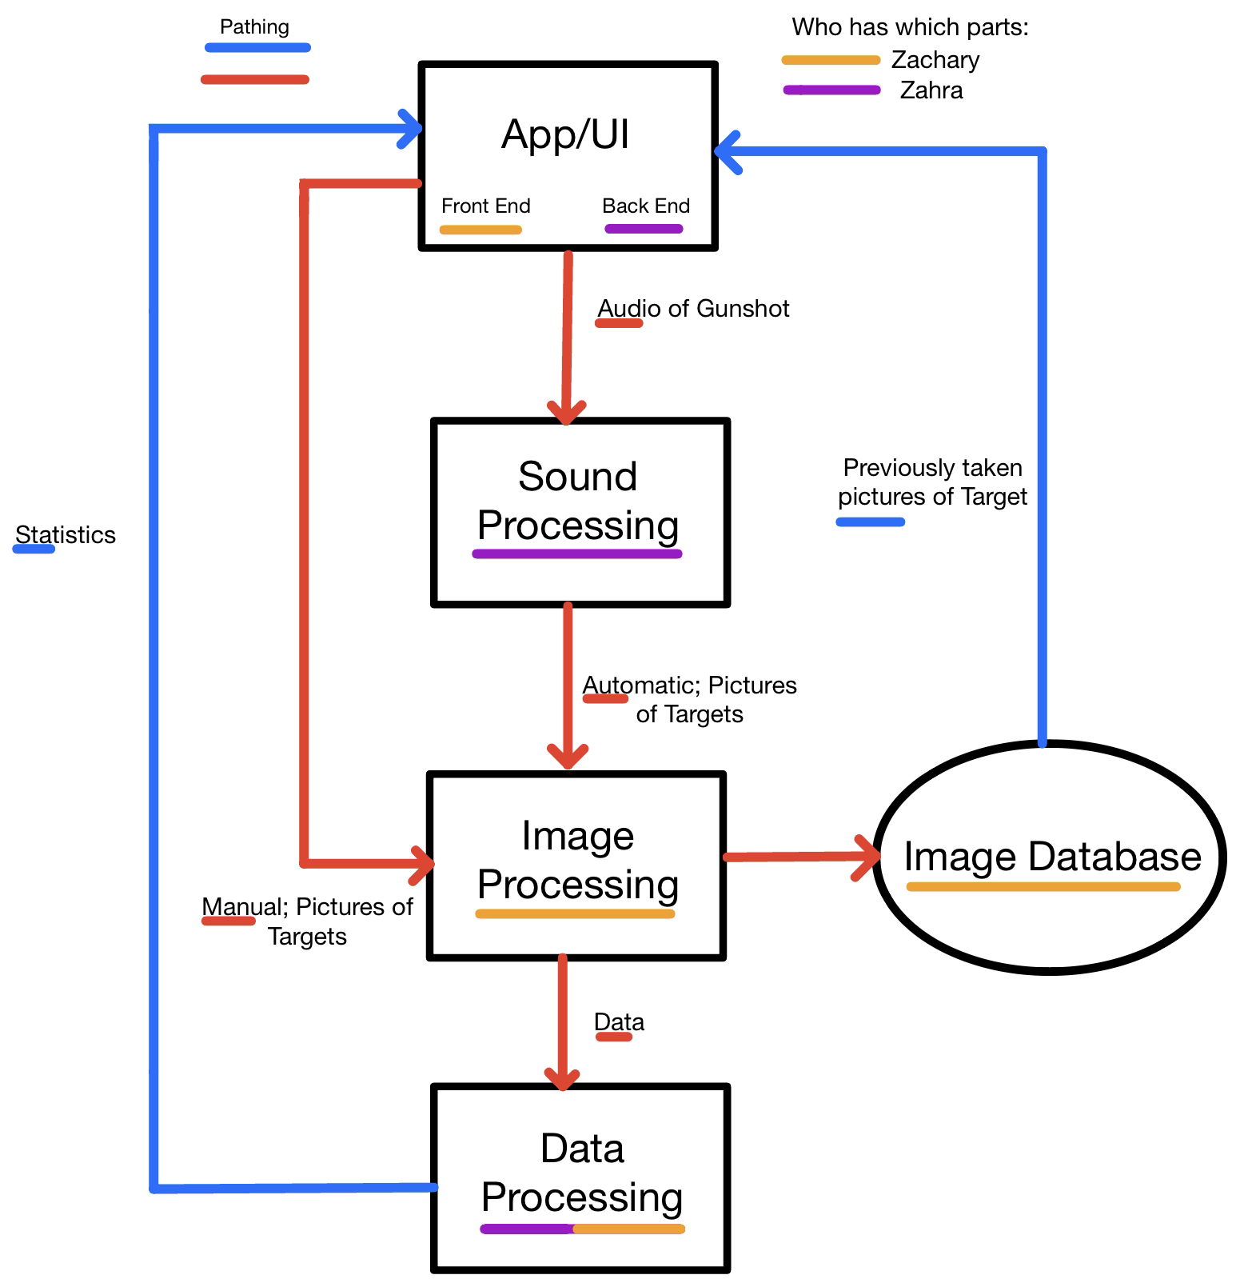
System Overview
5 Core systems:
App/Ui
Sound Processing
Image Processing
Image Database
Data Processing

Slide 4
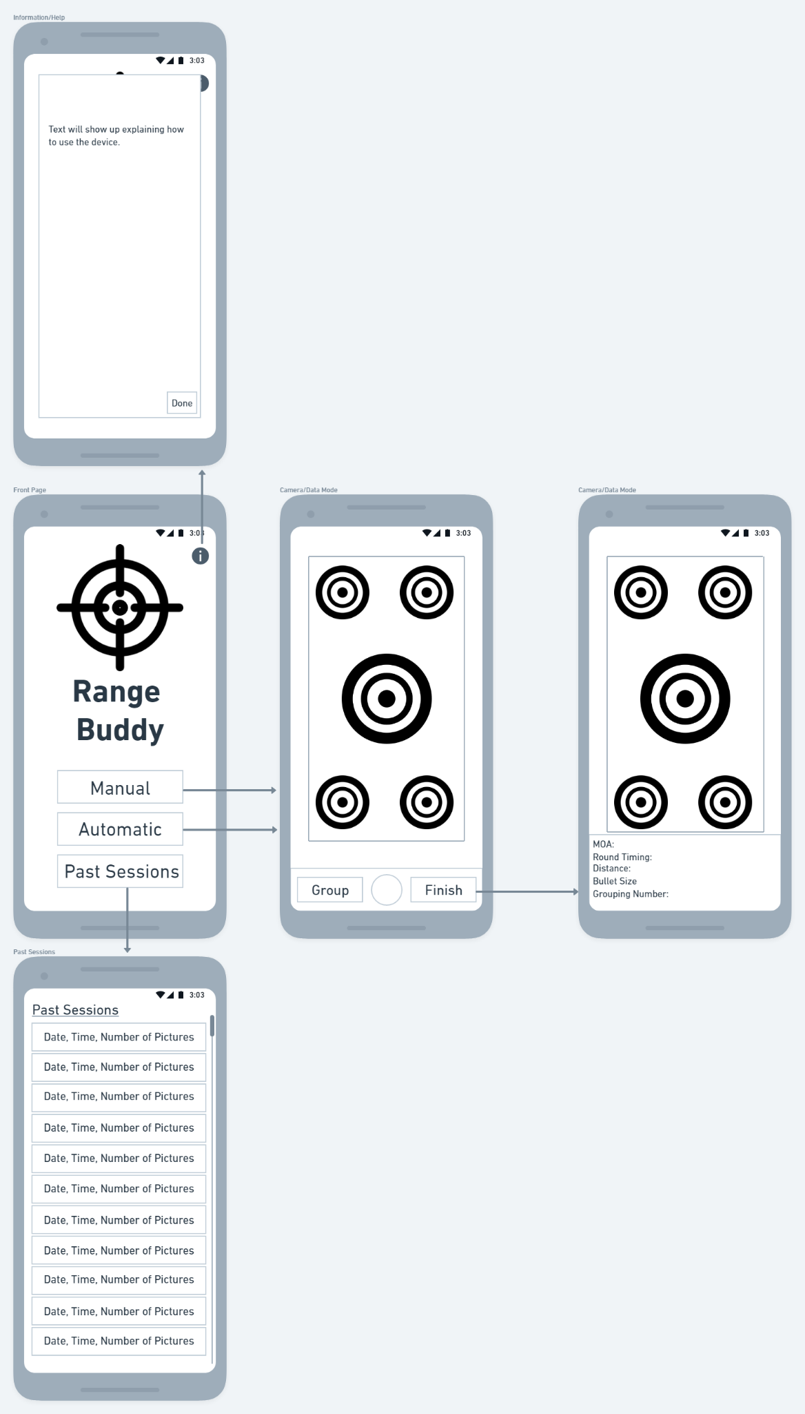
App/UI
4.5 main screens:
Main Screen
Photo Screen
Data Screen
Past Session Screen
Tutorial/Help Screen

Slide 5
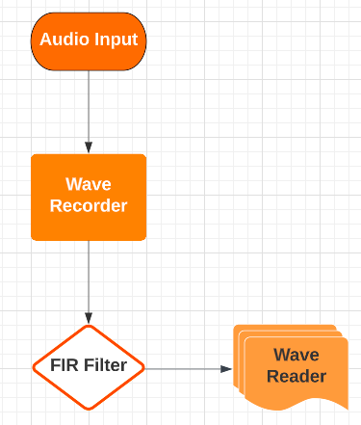
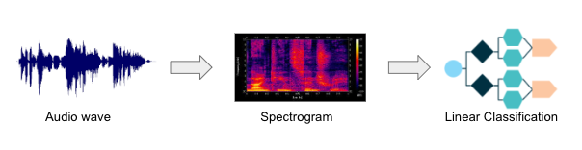
Audio Processing
Audio Classification
Utilize Machine Learning to take in test pattern shots to make up the training models.
Input audio file and compare to training data audio in order to trigger automatic operation.
When the similar gunshot is heard it will signal the application to take a picture.

Slide 6
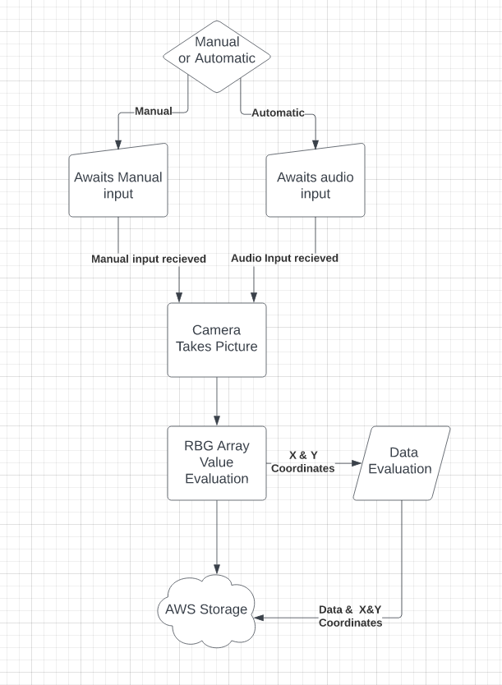
Image Processing & Database
Acquire JPEG picture either from a manual or automatic mode.
arrays of RGB pixels are searched for a bullet hole on the target.
X & Y Coordinates saved into storage with corresponding picture.
Using Kotlin for coding as it has a useful library for image processing

Slide 7
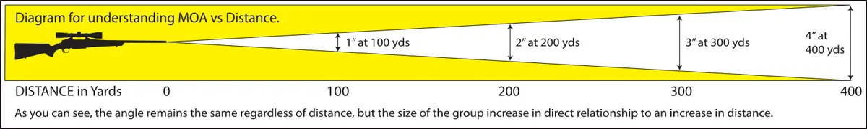
Data Processing
Takes X & Y coordinates from the RGB arrays to calculate statistics. These statistics are:
MoA
Round Timing
Group Size
These statistics will be given in both over time and per grouping.
Notes:
Records time from first shot to last shot and divides by number of photos taken

Slide 8
Execution & Validation
 | March 10th | March 29th | April 12th | April 23rd
Android App Functions | UI design is made. | Camera can be used inside the app. | Back end Finished. | App can move between each panel & call camera.
Gunshot Audio Recognition | System is able to record and process an audio file | 50% of machine learning test data. | System is able to classify a gun shot audio. | System is able to recognize a gunshot sound that matches.
Cloud Server | Data server is Acquired | Filing for sessions is organized | App can send and receive data from Cloud server. | Data can sent and recalled per session and per group.
Statistics | How to calculate each statistic | System is able to capture location values of point of impact. | location inputs are able to output statistics | Each statistic are calculable from the photos.
Camera | Camera can take clean pictures of targets up to 20 yards | Camera can be used inside the app | Manual operations is functionable in app | System is able to take a clear photo of a target up to 20 yards away

Slide 9
Questions?

